Slide 1

SCS1301 - OPERATING SYSTEM
UNIT – 1
INTRODUCTION TO OS
Dr.R.Subhashini
Professor and Head
Dept. of Information Technology
School of Computing

Slide 2
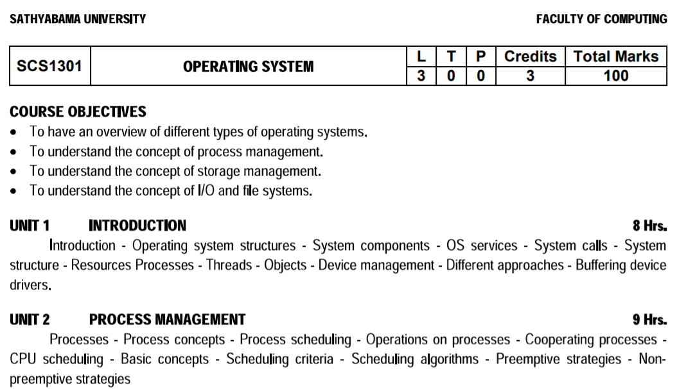

Slide 3
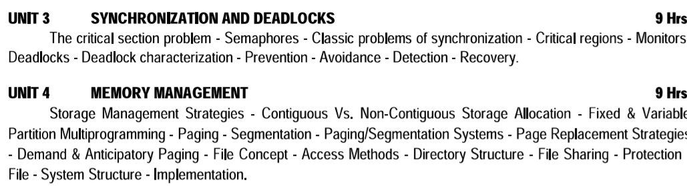

Slide 4
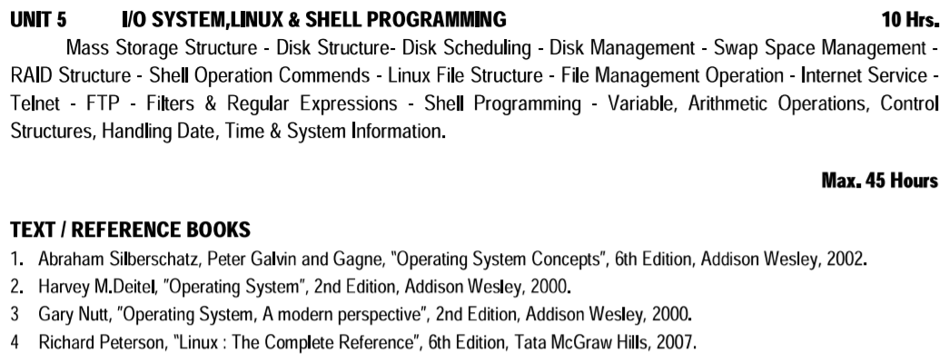

Slide 5
INTRODUCTION TO OS
A computer system has many resources (hardware and software), which may be require to complete a task.
Operating System is a system software that acts as an intermediary between a user and Computer Hardware to enable convenient usage of the system and efficient utilization of resources.
The commonly required resources are input/output devices, memory, file storage space, CPU etc.
The operating system acts as a manager of the above resources and allocates them to specific programs and users, whenever necessary to perform a particular task.
The resources are processor, memory, files, and I/O devices. In simple terms, an operating system is the interface between the user and the machine.
Therefore operating system is the resource manager i.e. it can manage the resource of a computer system internally.

Slide 6
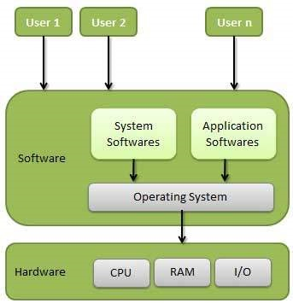
INTRODUCTION TO OS

Slide 7
GOALS OF OPERATING SYSTEM
Execute user programs
Make solving user problems easier.
Make the computer system convenient to use.
Use the computer hardware in an efficient manner.

Slide 8
FUNCTIONS OF OPERATING SYSTEM / SYSTEM COMPONENTS
Main Memory Management
Processor Management
Device Management
File Management
I/O System Management
Secondary Management
Networking
Protection System
Command Interpreter System

Slide 9
MEMORY MANAGEMENT
Memory management refers to management of Primary Memory or Main Memory. Main memory is a large array of words or bytes where each word or byte has its own address.
Main memory provides a fast storage that can be accessed directly by the CPU.
ACTIVITIES
Keeps tracks of primary memory, i.e., what part of it are in use by whom, what part is not in use.
In multiprogramming, the OS decides which process will get memory when and how much.
Allocates the memory when a process requests it to do so.
De-allocates the memory when a process no longer needs it or has been terminated

Slide 10
PROCESSOR MANAGEMENT
In multiprogramming environment, the OS decides which process gets the processor when and for how much time. This function is called process scheduling
ACTIVITIES
Keeps tracks of processor and status of process. The program responsible for this task is known as traffic controller.
Allocates the processor (CPU) to a process.
De-allocates processor when a process is no longer required.

Slide 11
DEVICE MANAGEMENT
An Operating System manages device communication via their respective drivers
ACTIVITIES
Keeps tracks of all devices. Program responsible for this task is known as the I/O controller.
Decides which process gets the device when and for how much time.
Allocates the device in the efficient way.
De-allocates devices.

Slide 12
FILE MANAGEMENT
A file system is normally organized into directories for easy navigation and usage. These directories may contain files and other directions.
ACTIVITIES
Keeps track of information, location, uses, status etc. The collective facilities are often known as file system.
Decides who gets the resources.
Allocates the resources.
De-allocates the resources

Slide 13
I/O SYSTEM MANAGEMENT
OS hides the peculiarities of specific hardware devices from the user.
ACTIVITIES
A general device-driver interface
Drivers for specific hardware devices.
Only the device driver knows the peculiarities of the specific device to which it is assigned.

Slide 14
SECONDARY STORAGE MANAGEMENT
The main purpose of a computer system is to execute programs. These programs, with the data they access, must be in main memory, or primary storage.
Systems have several levels of storage, including primary storage, secondary storage and cache storage.
ACTIVITIES
Free-space management (paging/swapping)
Storage allocation (what data goes where on the disk)
Disk scheduling (Scheduling the requests for memory access).

Slide 15
NETWORKING
A distributed systems are a collection of processors that do not share memory, peripheral devices, or a clock.
The processors in the system are connected through a communication-network. Communication takes place using a protocol. The network may be fully or partially connected
The communication-network design must consider routing and connection strategies.
ACTIVITIES
Computation Speed-up
Increased functionality
Increased data availability
Enhanced reliability

Slide 16
PROTECTION SYSTEM
If a computer system has multiple users and allows the concurrent execution of multiple processes, then the various processes must be protected from one another's activities.
Protection refers to mechanism for controlling the access of programs, files, memory segments, processes (CPU) only by the users who have gained proper authorization from the OS.
ACTIVITIES
Distinguish between authorized and unauthorized usage.
Specify the controls to be imposed.
Provide a means of enforcement.

Slide 17
COMMAND INTERPRETER SYSTEM
A command interpreter is one of the important system programs for an OS.
It is an interface of the operating system with the user. The user gives commands, which are executed by Operating system (usually by turning them into system calls).
The main function of a command interpreter is to get and execute the next user specified command.
ACTIVITIES
process creation and management
I/O handling
secondary-storage management
main-memory management
file-system access
protection
networking

Slide 18
CLASSIFICATION OF OPERATING SYSTEM
Multi-user OS : Allows two or more users to run programs at the same time.
Multiprocessing OS : Support a program to run on more than one central processing unit (CPU) at a time.
Multitasking OS : Allows to run more than one program at a time
Multithreading OS : Allows different parts of a single program to run concurrently (simultaneously or at the same time).
Real time OS : These are designed to allow computers to process and respond to input instantly

Slide 19
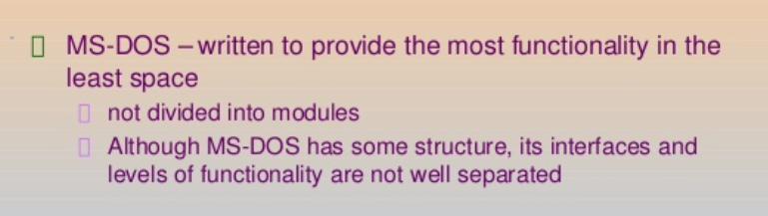
OPERATING SYSTEM STRUCTURES
A SIMPLE STRUCTURE: There are many operating systems that have a rather simple structure.
These started as small systems and rapidly expanded much further than their scope. A common example of this is MS-DOS.
MS – DOS SYSTEM STRUCTURE

Slide 20
MS – DOS Structure
For efficient performance and implementation an OS should be partitioned into separate subsystems, each with carefully defined tasks, inputs, outputs, and performance characteristics.
Application Programming
Resident System Programming
MS-DOS Drivers
ROM - BIOS Device Drivers

Slide 21
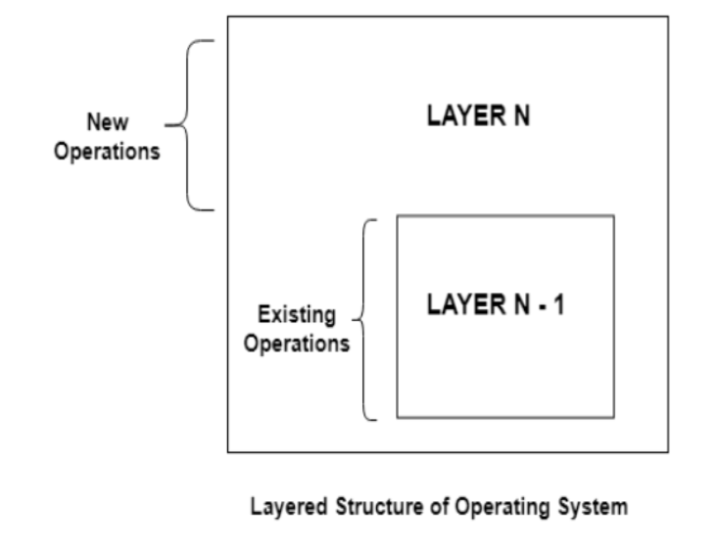
LAYERED STRUCTURE
One way to achieve modularity in the operating system is the layered approach. It breaks the OS into a number of smaller layers, each of which rests on the layer below it, and relies solely on the services provided by the next lower layer.

Slide 22
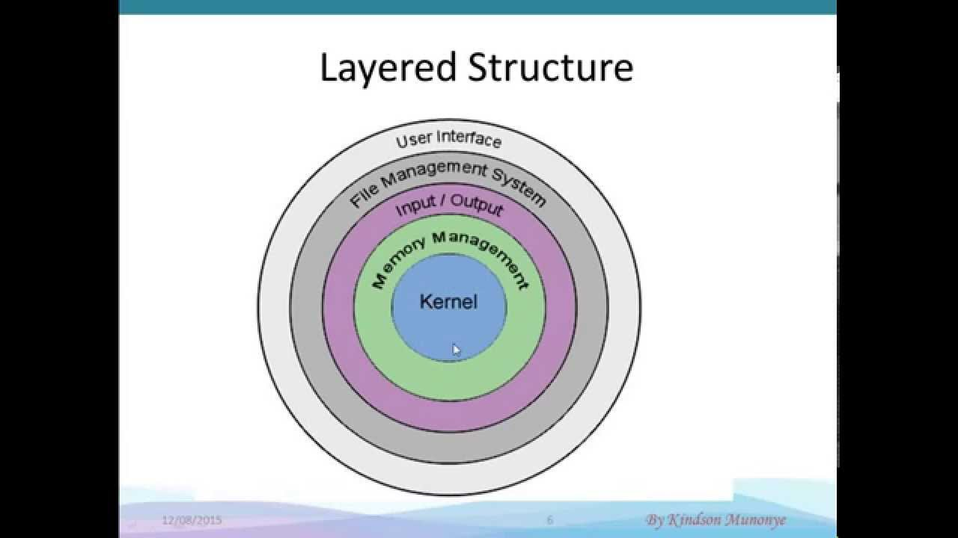

Slide 23
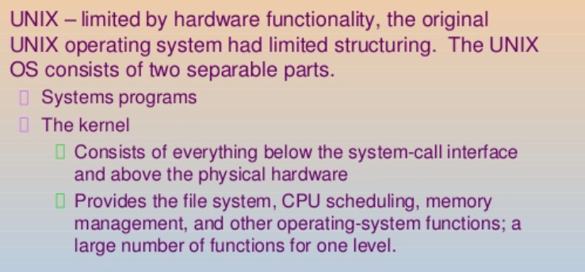
UNIX STRUCTURE

Slide 24
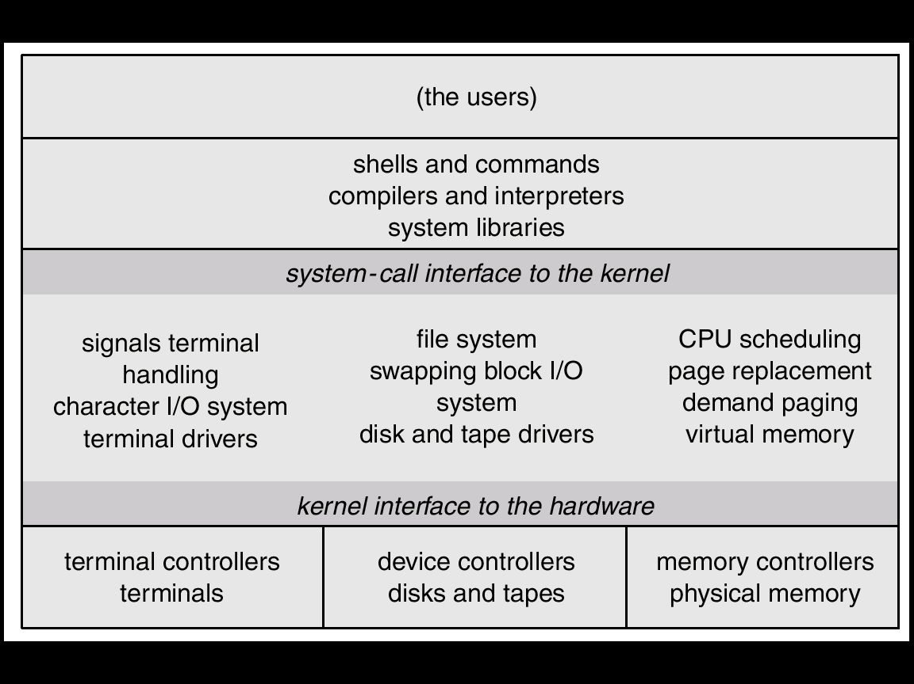
UNIX

Slide 25
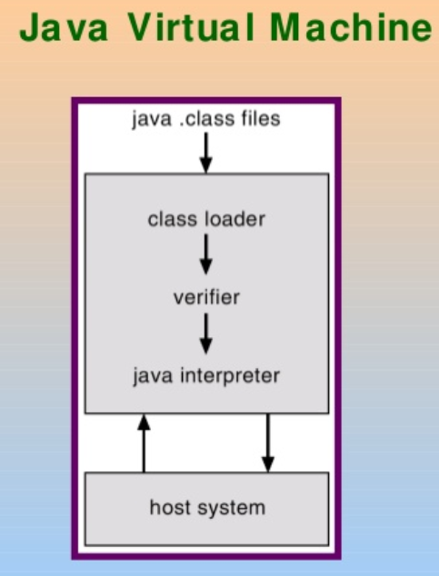
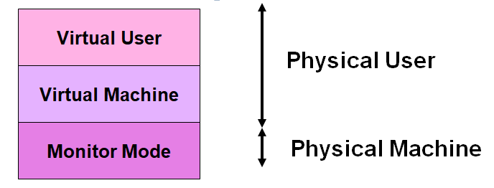
VIRTUAL MACHINE
In a Virtual Machine - each process "seems" to execute on its own processor with its own memory, devices, etc.
The resources of the physical machine are shared. Virtual devices are sliced out of the physical ones. Virtual disks are subsets of physical ones.

Slide 26
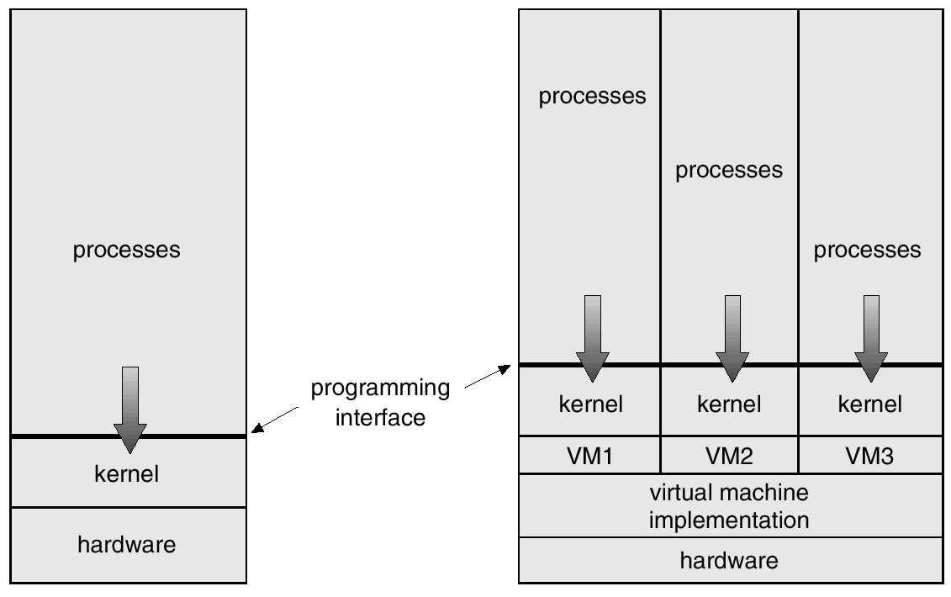
VIRTUAL MACHINE

Slide 27
OPERATING SYSTEM SERVICES
An OS provides environment for the execution of programs.
It provides certain services to programs and to the users of those programs.
These OS services are provided for the convenience of the programmer, to make the programming task easier. One set of operating-system services provides functions that are helpful to the user are,
PROGRAM EXECUTION
I/O OPERATIONS
FILE-SYSTEM MANIPULATION
COMMUNICATIONS
ERROR DETECTION
RESOURCE ALLOCATION
PROTECTION AND SECURITY

Slide 28
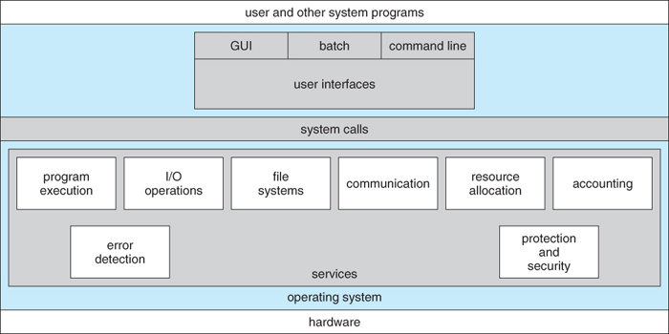
OPERATING SYSTEM SERVICES

Slide 29
SYSTEM CALLS
System calls provide the interface between a process and the operating system.
Typically written in a high-level language (C or C++)
Mostly accessed by programs via a high-level Application Program Interface (API) rather than direct system call use
Three most common APIs are Win32 API for Windows, POSIX API for POSIX-based systems (including virtually all versions of UNIX, Linux, and Mac OS X), and Java API for the Java virtual machine (JVM)

Slide 30
Illustrates the sequence of system calls required to copy a file

Slide 31
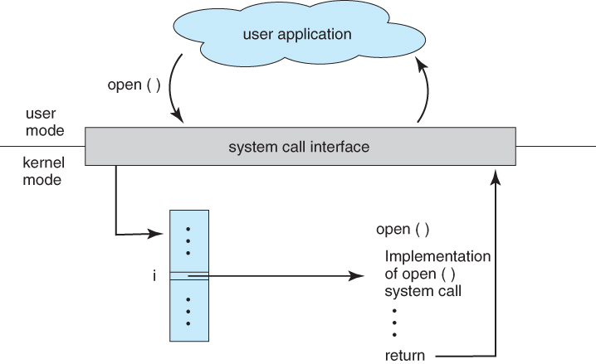
User application invoking the open( ) system call

Slide 32
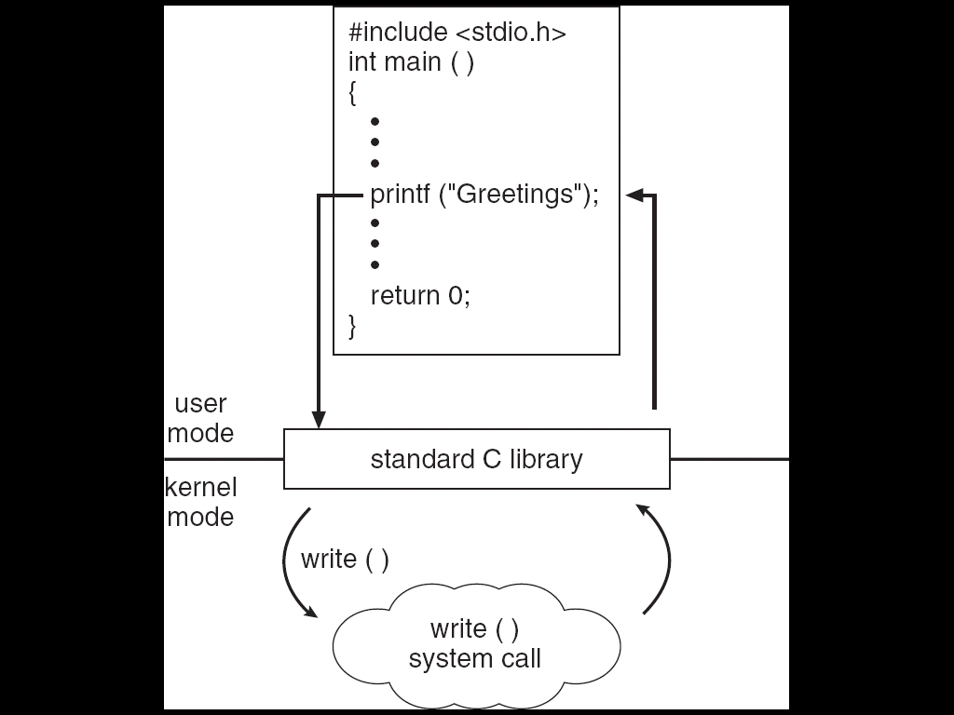
Standard C Library Example
C program invoking printf() library call, which calls write() system call

Slide 33
Three general methods are used to pass parameters between a running program and the operating system.
Simplest approach is to pass parameters in registers.
Store the parameters in a table in memory, and the table address is passed as a parameter in a register
Push (store) the parameters onto the stack by the program, and pop off the stack by operating system.

Slide 34
Passing of parameters as a table

Slide 35
TYPES OF SYSTEM CALLS
System calls can be grouped roughly in to five categories:
Process control
File management
Device management
Information maintenance
Communications

Slide 36
Types of System Calls
Process control
end, abort
load, execute
create process, terminate process
get process attributes, set process attributes
wait for time
wait event, signal event
allocate and free memory
File management
create file, delete file
open, close file
read, write, reposition
get and set file attributes

Slide 37
Types of System Calls (Cont.)
Device management
request device, release device
read, write, reposition
get device attributes, set device attributes
logically attach or detach devices
Information maintenance
get time or date, set time or date
get system data, set system data
get and set process, file, or device attributes
Communications
create, delete communication connection
send, receive messages
transfer status information
attach and detach remote devices

Slide 38
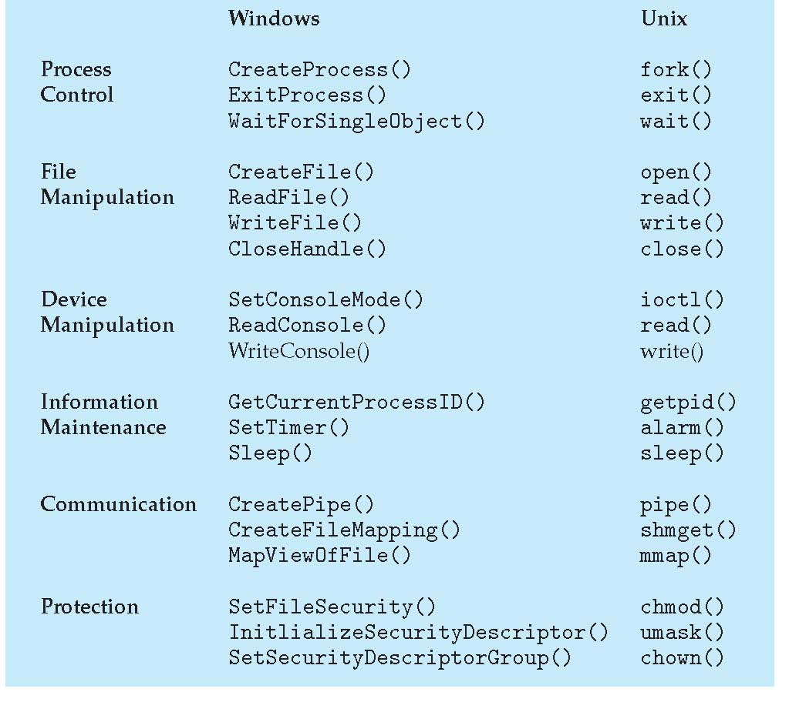
Examples of Windows and Unix System Calls

Slide 39
Processes
A process can be thought of as a program in execution, A process will need certain resources
such as CPU time, memory, files, and I/O devices
to accomplish its task.
Process is an Active Entity and Program is a Passive Entity.
A process is the unit of work in most systems.
Systems consist of a collection of processes:
Operating-system processes execute system code, and
user processes execute user code.
All these processes may execute concurrently.

Slide 40
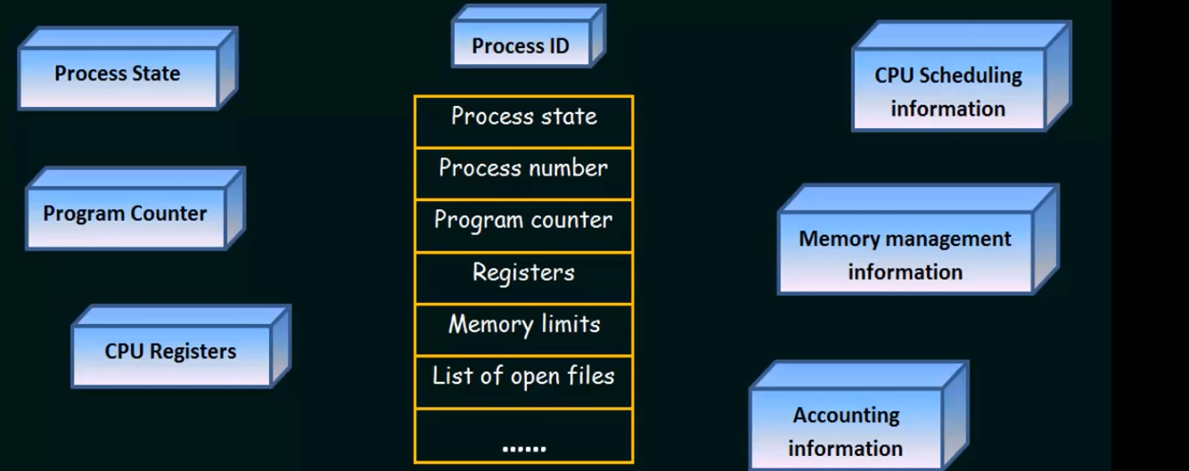
Process Control Block(data structure used by computer operating systems to store all the information about a process)

Slide 41
Process Control Block
Process ID (PID)–unique identification number for each process
Process State–New, Ready, Running, Waiting, Terminated
Program Counter (PC)–A pointer to the address of the next instruction to be executed for this process
List of Open files– This information includes the list of files opened for a process.
Memory limits – This field contains the information about memory management system used by operating system.
CPU Registers–Register set where process needs to be stored for execution for running state eg: accumulator, base and general purpose registers.

Slide 42
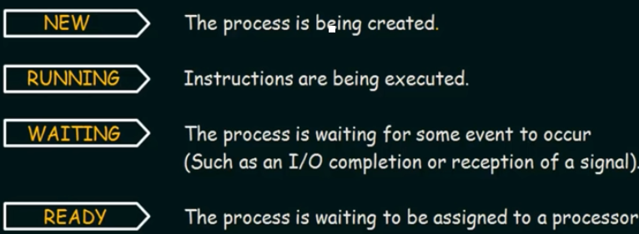
Process States

Slide 43
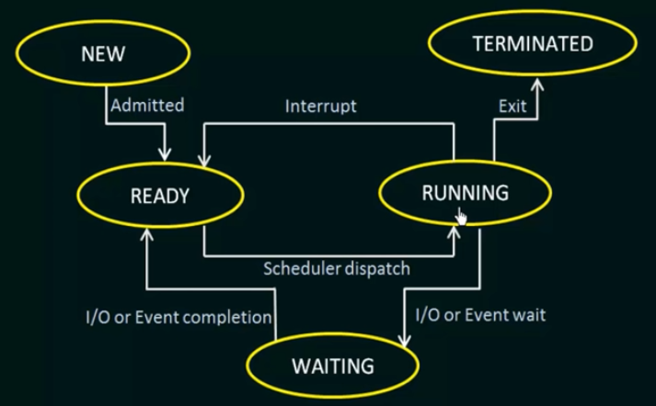
Process States

Slide 44
Resources
The OS treats an entity as a resource if it satisfies the below characteristics:
A process must request it from the OS.
A process must suspend its operation until the entity is allocated to it.
The most common source is a file. A process must request a file before it can read it or write it. Further, if the file is unavailable, the process must wait until it becomes available. This abstract description of a resource is crucial to the way various entities(such as files, memory and devices) are managed.

Slide 45
Thread
A thread is a basic unit of CPU utilization. A thread, sometimes called as light weight process whereas a process is a heavyweight process.
Thread comprises:
A thread ID
A program counter
A register set
A stack.
A process is a program that performs a single thread of execution i.e., a process is a executing program with a single thread of control. For example, when a process is running a word- processor program, a single thread of instructions is being executed.

Slide 46
Thread
The single thread of control allows the process to perform only one task at one time. For example, the user cannot simultaneously type in characters and run the spell checker within the same process.
Traditionally a process contained only a single thread of control as it ran, many modern operating systems have extended the process concept to allow a process to have multiple threads of execution and thus to perform more than one task at a time.
For example, in a browser, multiple tabs can be different threads

Slide 47
Thread
The operating system is responsible for the following activities in connection with process and thread management:
The creation and deletion of both user and system processes
The scheduling of processes
The provision of mechanisms for synchronization
Communication
Deadlock handling for processes.

Slide 48
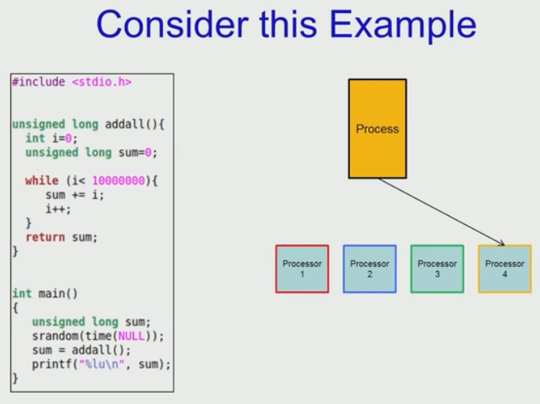
Process Model

Slide 49
Thread Model

Slide 50
Creation time for 50,000 Process and Thread

Slide 51
Applications

Slide 52
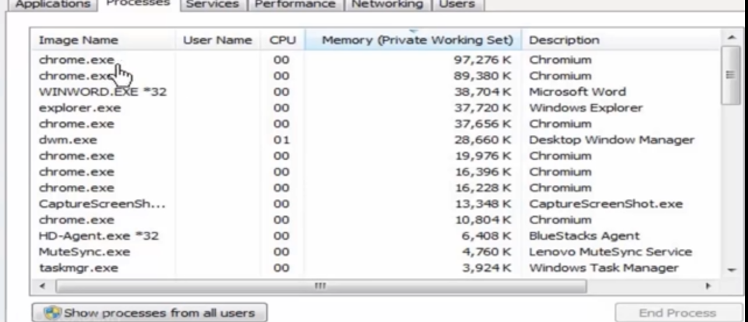
Processes

Slide 53
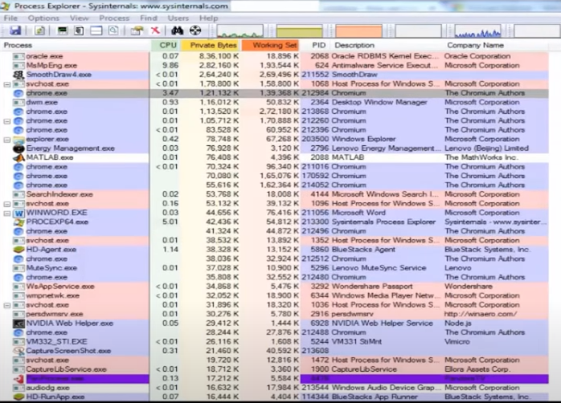
Processes

Slide 54
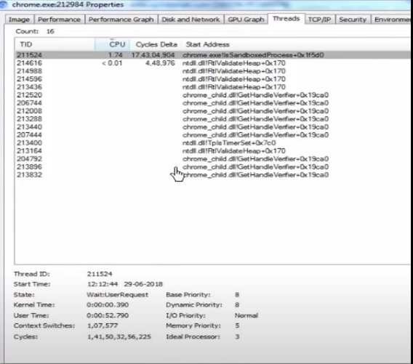
Thread

Slide 55
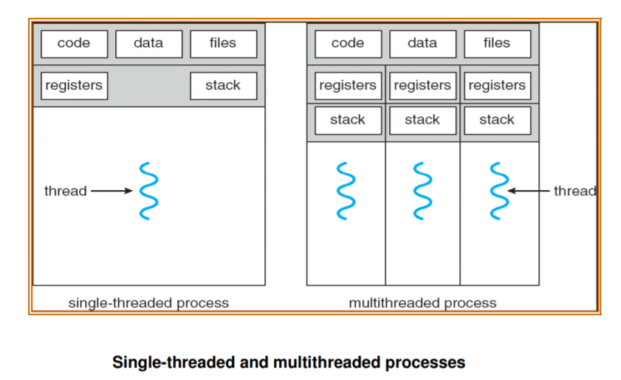
Thread

Slide 56
Benefits
The benefits of multi threaded programming can be broken down into four major categories:
Responsiveness
Multi threading an interactive application may allow a program to continue running even if part of it is blocked or is performing a lengthy operation, thereby increasing responsiveness to the user. A multi threaded web browser could still allow user interaction in one thread while an image was being loaded in another thread.
Resource sharing
By default, threads share the memory and the resources of the process to which they belong. The benefit of sharing code and data is that it allows an application to have several different threads of activity within the same address space.

Slide 57
Benefits
Economy
Allocating memory and resources for process creation is costly. Because threads share resources of the process to which they belong, it is more economical to create and context-switch threads.
It is much more time consuming to create and manage processes than threads. In Solaris, for example, creating a process is about thirty times slower than is creating a thread, and context switching is about five times slower.
Utilization of multiprocessor architectures
The benefits of multithreading can be greatly increased in a multiprocessor architecture, where threads may be running in parallel on different processors.
A single threaded process can only run on one CPU, no matter how many are available.
Multithreading on a multi-CPU machine increases concurrency.

Slide 58
User Level Thread
User threads are supported above the kernel and are managed without kernel support i.e., they are implemented by thread library at the user level. These are the threads that application programmers use in their programs.
The library provides support for thread creation, scheduling and management with no support from the kernel.
Because the kernel is unaware of user-level threads, all thread creation and scheduling are done in user space without the need for kernel intervention.
Therefore, user-level threads are generally fast to create and manage. User-thread libraries include POSIX Pthreads, Mach C-threads, and Solaris 2 UI-threads.

Slide 59
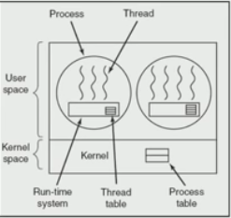
User Level Thread
Advantage:
Fast
Thread Management happens with thread
library.
Drawback:
Lack of Coordination between Kernel and
Thread
If one thread invokes system call, all threads
has to wait

Slide 60
Kernel Level Thread
Kernel threads are supported and managed directly by the operating system.
The kernel performs thread creation, scheduling and management in kernel space.
Since thread management is done by the operating system, kernel threads are generally slower to create and manage than are user threads.
Also, in a multiprocessor environment, the kernel can schedule threads on different processors. Most contemporary operating systems—including Windows NT, Windows 2000, Solaris 2,BeOS, and Tru64 UNIX (formerly Digital UNIX)—support kernel threads

Slide 61
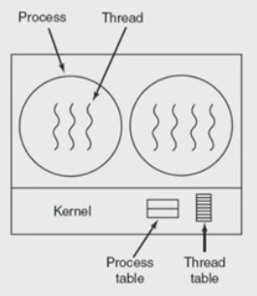
Kernel Level Thread
Advantage:
Scheduler can decide to give more time to process
having more threads
IF a Thread invokes a system call the remaining
thread will run.
Drawback:
Slow
Overhead to manage thread and process

Slide 62
Multithreading Models
Some operating system provide a combined user level thread and Kernel level thread facility. Eg. Solaris.
Three common ways of establishing this relationship are:
Many-to-One Model
One-to-one Model
Many-to-Many Model

Slide 63
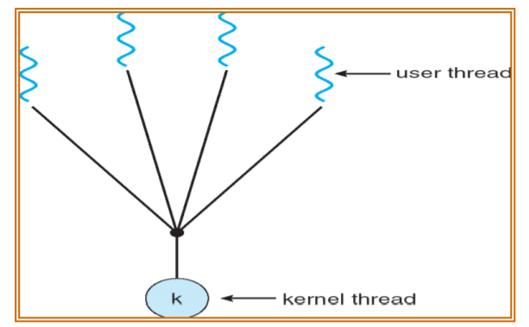
Many-to-One Model

Slide 64
Many-to-One Model
The many-to-one model maps many user-level threads to one kernel thread.
Thread management is done by the thread library in user space, so it is efficient; but the entire process will block if a thread makes a blocking system call.
Also, because only one thread can access the kernel at a time, multiple threads are unable to run in parallel on multiprocessors. Green threads—a thread library available for Solaris 2—uses this model.

Slide 65
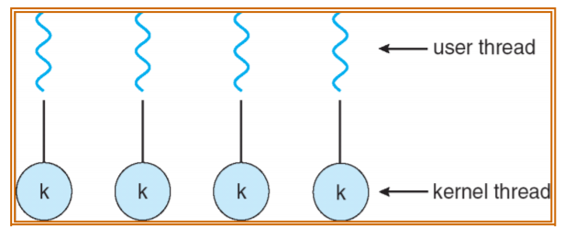
One-to-One Model

Slide 66
One-to-One Model
The one-to-one model maps each user thread to a kernel thread. It provides more concurrency than the many-to-one model by allowing another thread to run when a thread makes a blocking system call.
It also allows multiple threads to run in parallel on multiprocessors.
The only drawback to this model is that creating a user thread requires creating the corresponding kernel thread.
Linux, along with the family of Windows operating systems—including Windows 95, 98, NT, 2000, and OS/2— implement the one-to-one model.

Slide 67
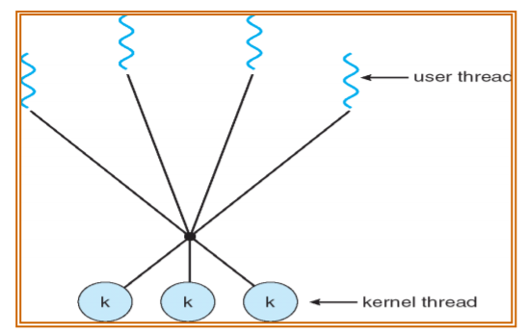
Many-to-Many Model

Slide 68
Many-to-Many Model
The many-to-many model multiplexes many user-level threads to a smaller or equal number of kernel threads.
The one-to-one model allows for greater concurrency, but the developer has to be careful not to create too many threads within an application.
The many-to-many model suffers from neither of these shortcomings: Developers can create as many user threads as necessary, and the corresponding kernel threads can run in parallel on a multiprocessor. Also, when a thread performs a blocking system call, the kernel can schedule another thread for execution. Solaris 2, IRIX, HP-UX and Tru64 UNIX support this model.

Slide 69
Identification of Core:(Windows Management Interface Command)
C:\Users\Ajitha>wmic
wmic:root\cli>CPU Get NumberOfCores
NumberOfCores
4
wmic:root\cli>CPU Get NumberOfCores,NumberOFLogicalProcessors
NumberOfCores NumberOfLogicalProcessors
4 8
wmic:root\cli>

Slide 70
Difference between Process and Thread
Sl.No | Process | Thread
1 | Process means any program is in execution. | Thread means segment of a process.
2 | It takes more time for creation. | It takes less time for creation.
3 | Process is called heavy weight process. | Thread is called light weight process.
4 | Process switching needs interaction with operating system | Thread switching does not need to interact with operating system
5 | In multiple processing environments each process executes the same code but has its own memory and file resources | All threads can share same set of open files, Child processes

Slide 71
Object
Objects are the basic run time entities in an object-oriented system.
They may represent a person, a place, a bank account,a table of data or any item that the program has to handle.
Programming problem is analysed in terms of objects and the nature of communication between them.
When a program is executed,the objects interact by sending messages to one another.
For example, if ‘customer’ and ‘account’ are the two objects in a program, then the customer object may send a message to the account object.
Each object contains data and code to manipulate the data.

Slide 72
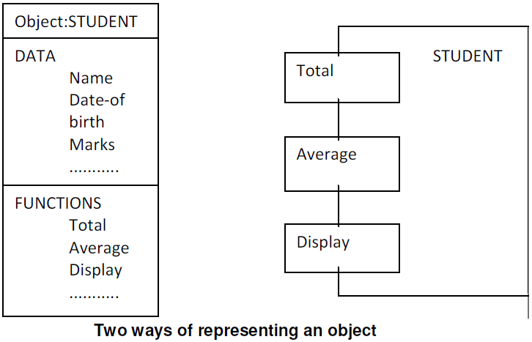

Slide 73
Real-world objects share two characteristics: They all have state and behavior.
Desktop lamp may have only two possible states (on and off) and two possible behaviors (turn on, turn off), but your desktop radio might have additional states (on, off, current volume, current station) and behavior (turn on, turn off, increase volume, decrease volume, seek, scan, and tune).
You may also notice that some objects, in turn, will also contain other objects.
These real-world observations all translate into the world of object-oriented programming.

Slide 74
Device Management
Device management of operating system manages hardware devices via their respective drivers
It deals with the management of the I/O devices such as a keyboard, magnetic tape, disk, printer, microphone, USB ports, scanner, camcorder etc.as well as the supporting units like control channels.
The basics of I/O devices can fall into 3 categories:
Block device: it stores information in fixed-size block. example, disks.
Character device: it delivers or accepts a stream of characters. example printers, keyboards
Network device: For transmitting data packets.

Slide 75
Activities of Device Management
It keeps track of all the devices. The program responsible for keeping track of all the devices is known as I/O controller.
It provides a uniform interface to access devices with different physical characteristics.
It allocates the devices in an efficient manner.
It deallocates the devices after usage.
It decides which process gets the device and how much time it should be used.
It optimizes the performance of each individual device.

Slide 76
Approaches
Direct I/O
Memory Mapped I/O
Direct Memory Access

Slide 77
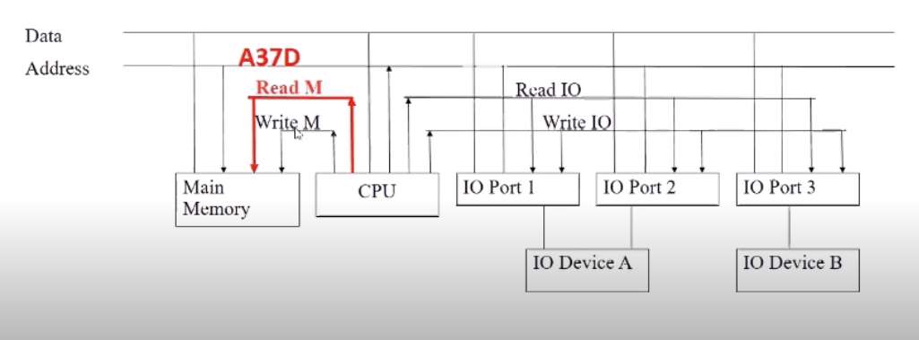
Direct I/O
CPU software explicitly transfer data to and from the controller’s data registers.
Separate Control signal for Memory and I/O Devices
Common Address and Data Bus for I/O Devices and Memory

Slide 78
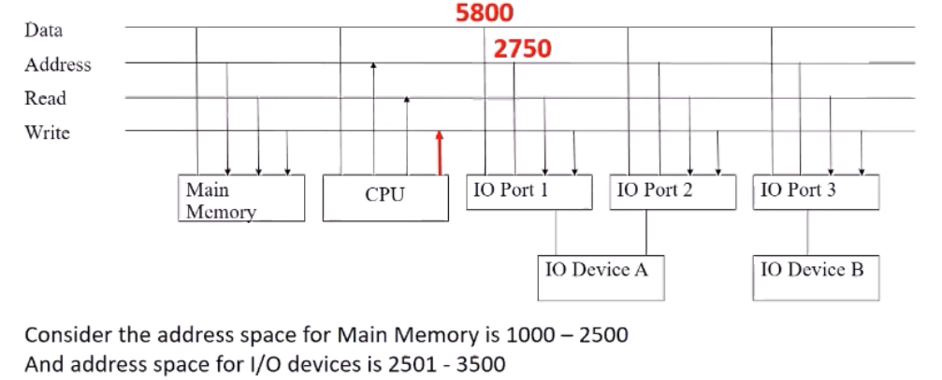
MEMORY MAPPED I/O
Device addressing simplifies the interface (device seen as a range of memory locations)
Common Control signal for Memory and I/O Devices
Common Address and Data Bus for I/O Devices and Memory

Slide 79
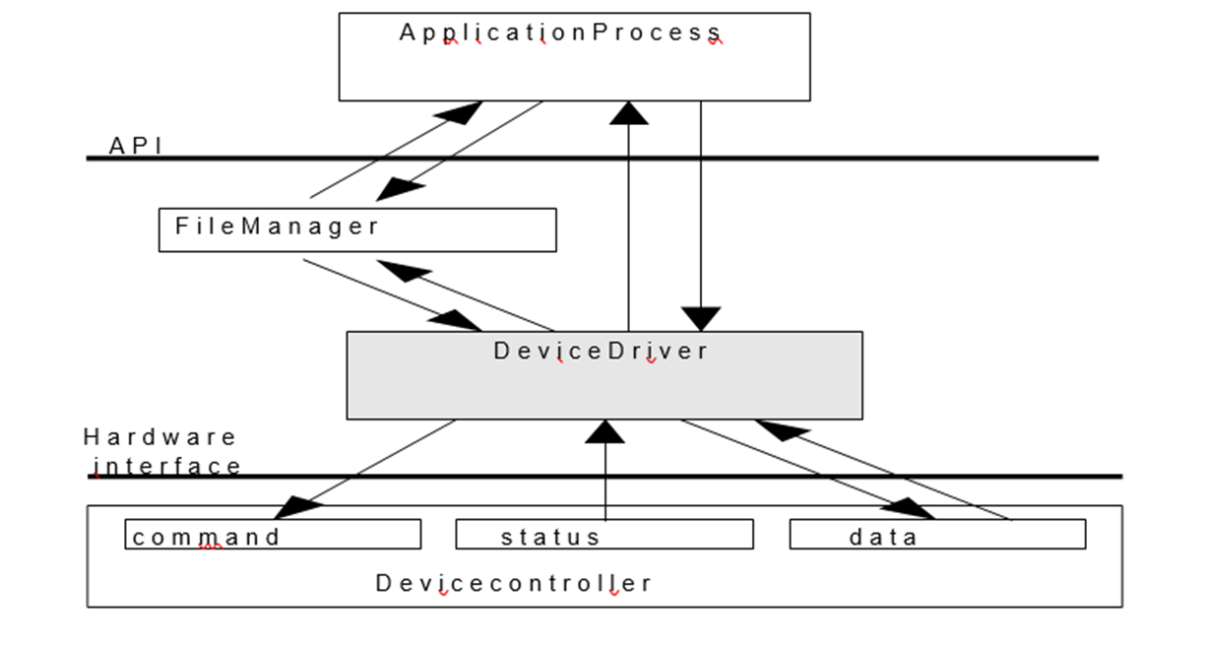
I/O System Organization

Slide 80
I/O System Organization
An application process uses a device by issuing commands and exchanging data with the device management (device driver).
Device driver responsibilities:
Implement communication APIs that abstract the functionality of the device
Provide device dependent operations to implement functions defined by the API
API should be similar across different device drivers, reducing the amount of info an application programmer needs to know to use the device

Slide 81
I/O System Organization
Since each device controller is specific to a particular device, the device driver implementation will be device specific, to
Provide correct commands to the controller
Interpret the controller status register (CSR) correctly
Transfer data to and from device controller data registers as required for correct device operation

Slide 82
I/O with polling
Each I/O operation requires that the software and hardware coordinate their operations to accomplish desired effect
In direct I/O polling this coordination is done in the device driver;
While managing the I/O, the device manager will poll the busy/done flags to detect the operation’s completion; thus, the CPU starts the device, then polls the CSR to determine when the operation has completed
With this approach is difficult to achieve high CPU utilization, since the CPU must constantly check the controller status

Slide 83
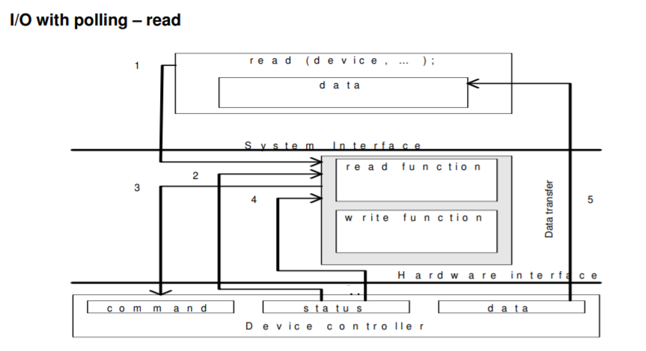

Slide 84
I/O with polling-read
Application process requests a read operation
The device driver queries the CSR to determine whether the device is idle; if device is busy, the driver waits for it to become idle
The driver stores an input command into the controller’s command register, thus starting the device
The driver repeatedly reads the content of CSR to detect the completion of the read operation
The driver copies the content of the controller's data register(s) into the main memory user’s process’s space.

Slide 85
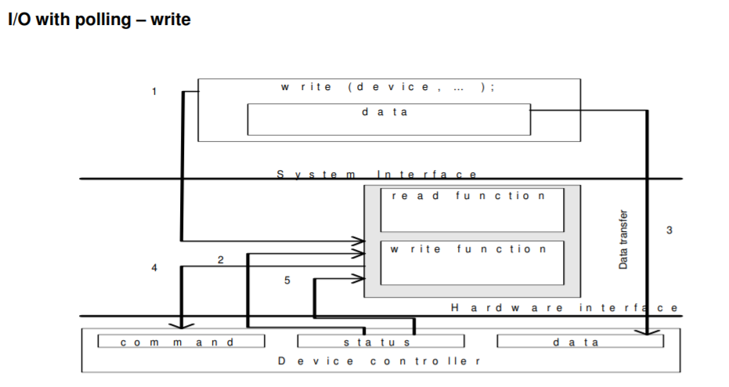

Slide 86
I/O with polling-write
The application process requests a write operation
The device driver queries the CSR to determine if the device is idle; if busy, it will wait to become idle
The device driver copies data from user space memory to the controller’s data register(s)
The driver stores an output command into the command register, thus starting the device
The driver repeatedly reads the CSR to determine when the device completed its operation.

Slide 87
Interrupt driven I/O
In a multiprogramming system the wasted CPU time (in polled I/O) could be used by another process; because the CPU is used by other processes in addition to the one waiting for the I/O operation completion.
This may be remedied by use of interrupts
The reason for incorporating the interrupts into a computer hardware is to eliminate the need for a device driver to constantly poll the CSR
Instead polling, the device controller “automatically” notifies the device driver when the operation has completed.

Slide 88
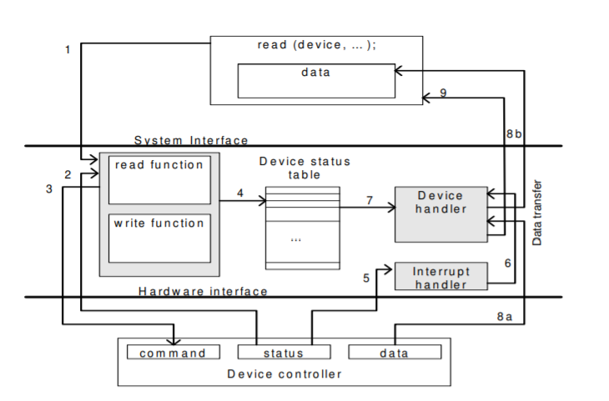

Slide 89
Interrupt driven I/O
The application process requests a read operation
The device driver queries the CSR to find out if the device is idle; if busy, then it waits until the device becomes idle
The driver stores an input command into the controller’s command register, thus starting the device
When this part of the device driver completes its work, it saves information regarding the operation it began in the device status table; this table contains an entry for each device in system; the information written into this table contains the return address of the original call and any special parameters for the I/O operation; the CPU, after doing this, can be used by other program, so the device manager invokes the scheduler part of the process manager. It then terminates

Slide 90
Interrupt driven I/O
The device completes the operation and interrupts the CPU, therefore causing an interrupt handler to run
The interrupt handler determines which device caused the interrupt; it then branches to the device handler for that device
The device driver retrieves the pending I/O status information from the device status table
(a,b) The device driver copies the content of the controller’s data register(s) into the user process’s space
The device handler returns the control to the application process (knowing the return address from the device status table). Same sequence (or similar) of operations will be accomplished for an output operation.

Slide 91
Buffering
Buffering is a technique by which a device manager keeps the slower I/O devices busy when a process is not requiring I/O operations.
A buffer is a memory area that stores data being transferred between two devices or between a device and an application.
Input buffering is the process of reading the data into the primary memory before the process requests it.
Output buffering is the process of saving the data in the memory and then writing it to the device while the process continues its execution.

Slide 92
Hardware level buffering
Consider a simple character device controller that reads a single byte form a modem for each input operation.
Normal operation: read occurs, the driver passes a read command to the controller; the
controller instructs the device to put the next character into one-byte data controller’s
register; the process calling for byte waits for the operation to complete and then retrieves
the character from the data register
Add a hardware buffer to the controller to decrease the amount of time the process has to wait
Buffered operation: the next character to be read by the process has already been
placed into the data register, even the process has not yet called for the read operation

Slide 93
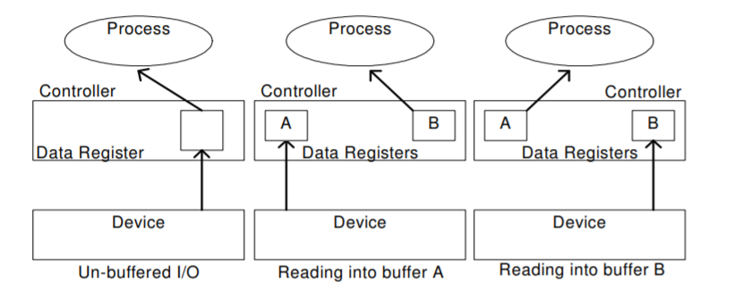
Hardware level buffering

Slide 94
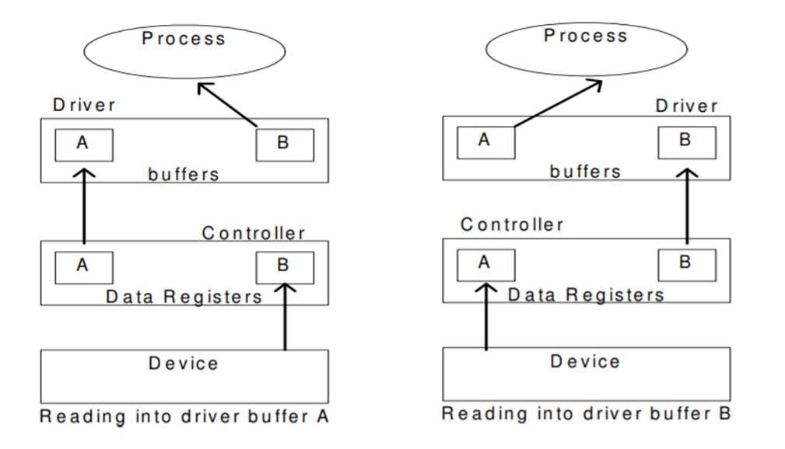
Driver level buffering
This is generally called double buffering. One buffer is for the driver to store the data while waiting for the higher layers to read it. The other buffer is to store data from the lower level module. This technique can be used for the block-oriented devices (buffers must be large enough to accommodate a block of data).

Slide 95
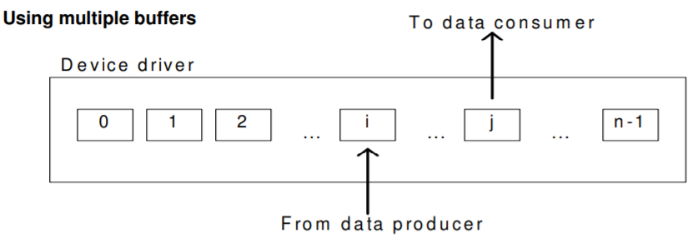
Driver level buffering
The number of buffers is extended from two to n. The data producer is writing into buffer i while the data consumer is reading from buffer j.
In this configuration buffers j+1 to n-1 and 0 to i-1 are full. This is known as circular buffering
technique.

Slide 96
Device driver
It is a software program that controls a particular type of device attached to the computer. It provides an interface to the hardware devices without the requirement to know the precise information about the hardware.
A device driver communicates with the device through a bus or communication sub system.
Responsibilities
Initialize devices
Interpreting the commands from the operating system
Manage data transfers
Accept and process interrupts
Maintain the integrity of driver and kernel data structures

Slide 97
Two ways of dealing with the device drivers
Old way: Driver is part of the operating system, to add a new device driver, the whole OS must have been complied
Modern way: Drivers installation is allowed without re-compilation of the OS by using reconfigurable device drivers; the OS dynamically binds the OS code to the driver functions.
A reconfigurable device driver has to have a fixed, standardized API
The Kernel has to provide an interface to the device driver to allocate/de-allocate space for buffers, manipulate tables in the kernel etc.

Slide 98
Reconfigurable device drivers

Slide 99
The driver - kernel interface
The OS uses an indirect reference table to access the different driver entry points, based on the device identifier and function name. The indirect reference table is filled with appropriate values whenever the device driver loads
When a process performs a system call, the kernel passes the call onto the device driver via the indirect reference table.

Slide 100
DIRECT MEMORY ACCESS
Involves designing of hardware to avoid the CPU perform the transfer of information between the device.
Normally Data transfer from I/O to Memory happens in two cycle.
I/O to CPU
CPU to Memory
Using DMA data can be transferred directly from I/O to Memory

Slide 101
Direct Memory Access
It consists of Four Blocks
CPU
DMAC(Direct Memory Access Controller)
Disk controller
Memory
Steps in Direct Memory Access
CPU will set the registers of DMAC(ie) Cpu programs the DMAC by setting its Registers
CPU instruct the disk controller to read the data from the drive and store it in buffer.
DMAC request disk controller to transfer data to memory
Disk Controller will transfer the data to memory
Disk Controller will send the acknowledgement to the DMA Controller after transferring the data.
After getting the acknowledgement the DMA Controller will decrement the count.
Once the Byte count is zero, it tells to CPU the Data transfer is over.

Slide 102
DIRECT MEMORY ACCESS

